Slide 1
Understanding American Government
The Role of Government in America
John DeGraca
POS 2041

Slide 2
Outline
Why do we have Government
The Founders Conceptions
Reasons for Government Expansion
Americans’ Ambivalence about Government
Opinions about Gov’t in the Obama Years
Trust and confidence in Government

Slide 3
Why have Government
In Democracies
To have a measure of control over the people
To have a monopoly on the use of military power
To protect personal freedom
To regulate society
2. In Dictatorships and Totalitarian nations
Regulate every aspect of life
3. Stateless state

Slide 4
How did the US developed the size of government we have? 1. The Founders conceptions
Early Settlers
Religious reasons
Economic reasons
The Constitution
Tenth Amendment (delegation of Power)
Flexibility to allow Constitution to expand
The Role of the People
To vote for members in the House of Rep

Slide 5
Reasons for Government Expansion
Why does Government Grow?
Civil War
Industrial Revolution
Great Depression (1929-1933)
New Deal; 16th Amendment (income, Tax)
World War II and the Cold War
Civil Rights Era
Great Society (9)
Backlash to Government Growth

Slide 6
Americans’ Ambivalence about Government
Public Opinion about Government Spending
Americans are of two minds about government size and activity
Cut spending
Increase number of programs
The Diversity of Antigovernment Groups
Supporters of smaller government shows their displeasure
They challenge power to tax
They challenge power to regulate
States rights

Slide 7
Opinions about Government in the Obama Years
Impact of Recession
2008-2009 level of unemployment
Loss of jobs
High mortgage rates
Bailouts
Reaction to President Obama
Many people did not trust him in matters of national economy; issues of birthplace; citizenship; religion
Reaction to Democratic Policies
Health care reform; climate change measures; education reform; and stabilize the economy

Slide 8
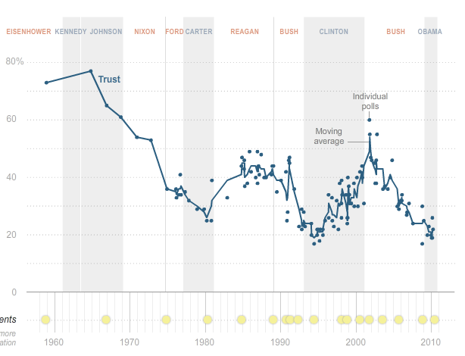
Trust and Confidence in Government

Slide 9
Conclusion
Founders distrusted government and today people have similar sentiments
The role of government should be minimal
Market forces should regulate the economy

